Slide 1




Learning R the hard way
Maani Beigy, MD-MPH

Slide 2
Universal Council of Epidemiology (UCE)
Universal Scientific Education and Research Network (USERN)
Students’ Scientific Research Center (SSRC)
Tehran University of Medical Sciences (TUMS)
HELLO!
I am Maani Beigy
Who R U ?
https://github.com/MaaniBeigy
https://www.researchgate.net/profile/Maani_Beigy
https://stackoverflow.com/users/9555505/maanib?tab=profile
https://orcid.org/0000-0003-2963-3533
www.linkedin.com/in/maani-beigy-69454438
<number>

Slide 3

Introduction
Why R?
<number>

Slide 4
Introduction: excellent
free
available
Open-source
importing and
manipulating
data
reproducible
research
packages
statistical modeling
machine learning
visualization
4

Slide 5
Introduction: excellent
fantastic community
Cutting edge tools
functional programming
integrated development environment (IDE)
RSTUDIO
create interactive websites:
Shiny
Writing
apps
Metaprogramming facilities
domain-specific languages (DSL)
SQL, mongoDB, C, C++
5

Slide 6
Introduction: bad
Much of the R code
more focused on results
Inconsistency
Lots of changes
Metaprogramming
a double-edged sword
profligate user
of memory
poorly written R code
can be terribly slow
6

Slide 7
Introduction: Data Science
Subject Matter Expertise
Traditional Software
(Danger Zone)
Traditional Research
Math & Statistics
Computer Science
Data Science
Unicorn
Machine Learning
<number>

Slide 8
Goals
Part 1
To provide an introduction to R software environment and programming
Part 2
To provide a hands-on experience with R statistical analyses
</>
<number>

Slide 9
</>
Part 1
R software environment and programming
<number>

Slide 10
What is R?
Programming language and software environment for statistical computing and graphics
Widely used among statisticians and data scientists
Excellent statistical facilities
Nearly everything you may need in terms of statistics has already been programmed and made available in R
either as part of the main packages or as a user-contributed packages
<number>

Slide 11
Learning R
R has a steep learning curve
<number>

Slide 12
History of R
R is an implementation of S programming language.
S was created by John Chambers in 1976 at Bell Labs.
R: Open source platform similar to S developed by Robert Gentleman and Ross Ihaka (U of Auckland) during the 1990s.
Since 1997, R has been developed by the R Development Core Team.
<number>

Slide 13
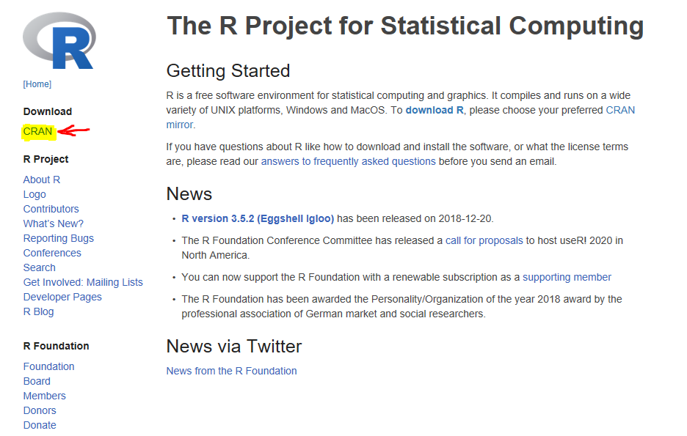
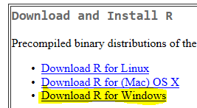
Download R
To obtain and install R on your computer:
Go to the R homepage https://www.r-project.org/
Click CRAN under Download
Choose a “mirror site”
Click Download R for Windows
Click base
Click Download R 3.5.2 for Windows
Note: Updated versions of R are available every few months.
<number>

Slide 14
Install and Use R
To install R click the downloaded file. The simplest procedure is to accept all default settings.
After installation, the R icon will appear on your desktop.
Lunch R by double-clicking the icon.
You will see the following R Windows
<number>

Slide 15
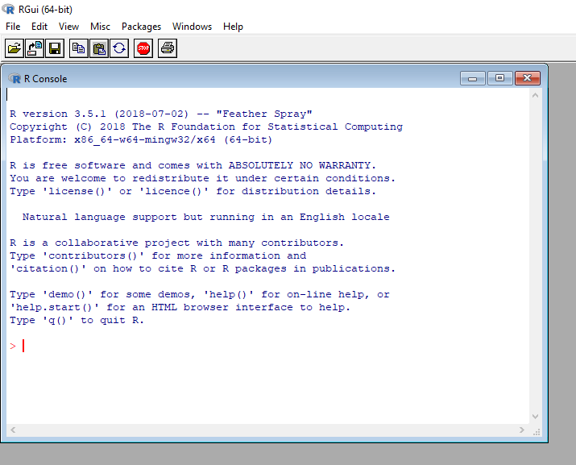
Install and Use R
Please type the following commands on R console and see what happens:
citation()
<number>

Slide 16

Install and Use RStudio
<number>

Slide 17
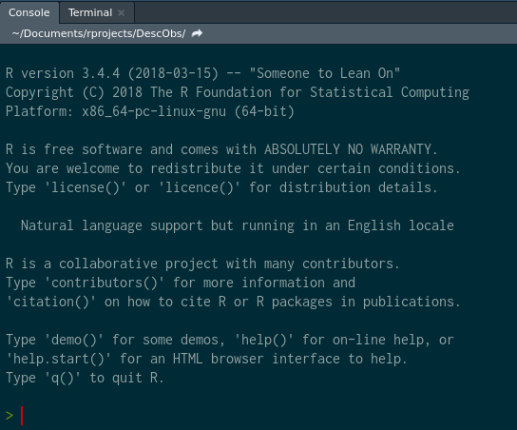
Console and Terminal
<number>

Slide 18
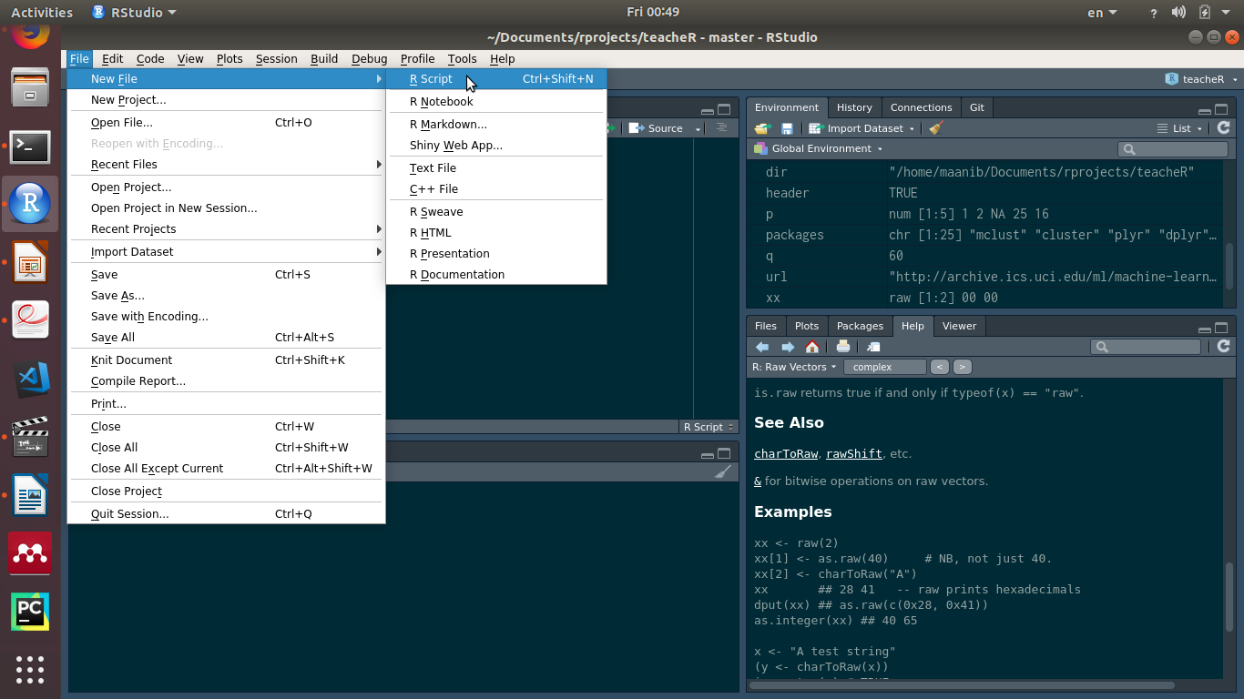
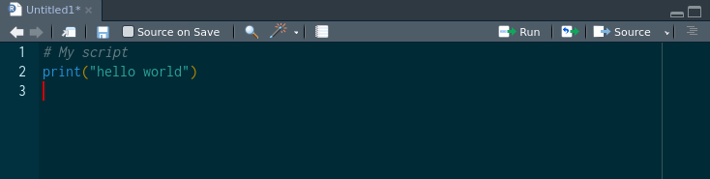
Script
<number>

Slide 19
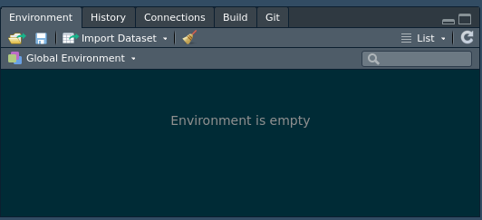
Environment
<number>

Slide 20
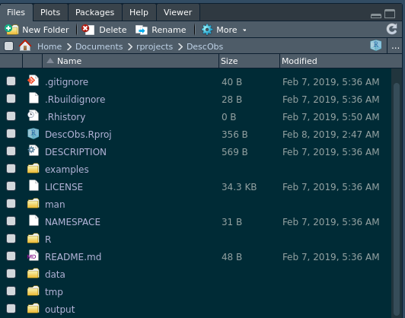
Outputs, Files, ...
<number>

Slide 21
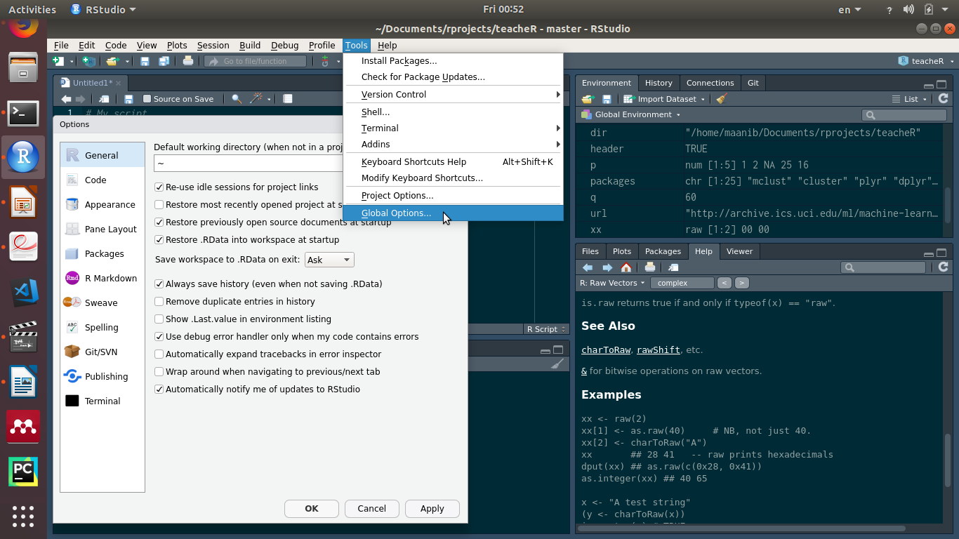
Setting and Options
<number>

Slide 22
Hello World!
> print("hello world")
[1] "hello world"
<number>

Slide 23
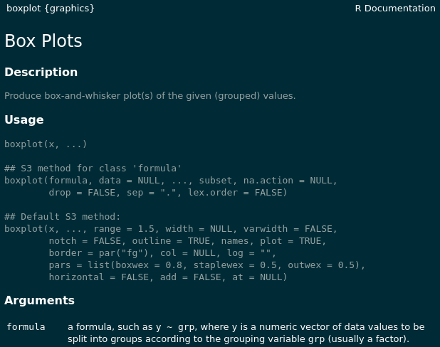
help("")
help("boxplot") or simply ?boxplot
<number>

Slide 24
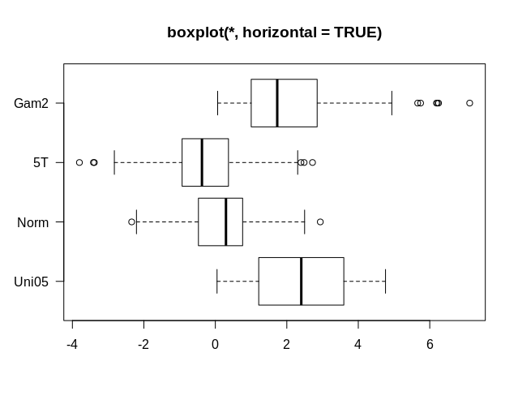
example("")
example("boxplot")
<number>

Slide 25
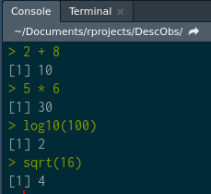
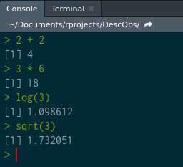
Typing Commands
?Arithmetic
<number>

Slide 26
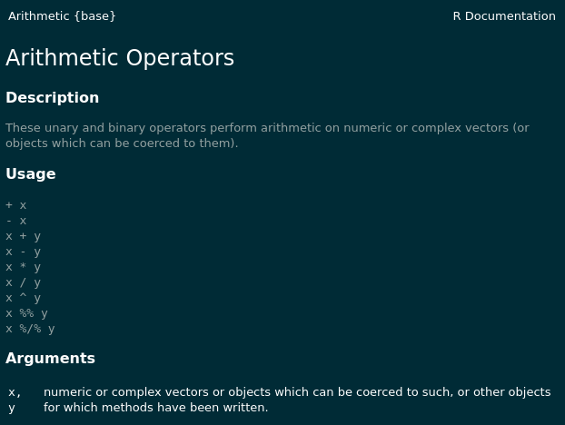
Typing Commands
<number>

Slide 27
Typing Commands
+ - * / ^
== equal
< smaller than
> greater than
<= smaller than or equal
>= greater than or equal
!= different
& and
| or
<number>

Slide 28
Typing Commands
quotient and remainder
To determine the quotient and remainder of a division, use the floor division and modulo operators, respectively
> 20 %/% 6 # quotient by floor division (%/%)
[1] 3
> 20 %% 6 # remainder by modulo (%%)
[1] 2
<number>

Slide 29
Assignment Operation
To assign a value to a variable use <- not =
> weight <- 72
> weight
[1] 72
To assign within a function use =
> mean(x = 1:100, na.rm = TRUE)
[1] 50.5
<number>

Slide 30
Assignment Example
> weight <- 72
> height <- 182
> BMI <- (weight)/(height/100)^2
> BMI
[1] 21.73651
> bmi
Error: object 'bmi' not found
<number>

Slide 31
Functions (if else)
Write a function for BMI
> BMI <- function(weight, height) {
if (height > 2.5) {
stop('height is not in meters')
} else (weight)/(height)^2
}
<number>

Slide 32
Data storage modes
"logical" TRUE or FALSE
"integer" 6L
"double" 6 or 6.0
"character" "m"
"list"
"function"
"complex" 3.141593+0i # rare
"raw" 2c 00 # rare
<number>

Slide 33
Data structures
dim | Homogeneous | Heterogeneous
1d | Atomic Vector | List
2d | Matrix | Data frame
nd | Array
<number>

Slide 34
Data structures
dim | Homogeneous | Heterogeneous
1d | Atomic Vector | List
2d | Matrix | Data frame
nd | Array
<number>

Slide 35
Data structures:
Atomic Vector
> a <- 8.4
> b <- "foo"
> str(a)
num 8.4
> str(b)
chr "foo"
> class(a)
[1] "numeric"
> class(b)
[1] "character"
> typeof(a)
[1] "double"
> typeof(b)
[1] "character"
<number>

Slide 36
Data structures:
Atomic Vector
Atomic vectors are usually created with c(), short for combine:
> dbl_var <- c(1, 2.5, 4.5)
# With the L suffix, you get an integer rather than a double
> int_var <- c(1L, 6L, 10L)
# Use TRUE and FALSE (or T and F) to create logical vectors
> log_var <- c(TRUE, FALSE, T, F)
> chr_var <- c("foo", "bar")
<number>

Slide 37
Data structures:
Atomic Vector: is.atomic()
> dbl_var <- c(1, 2.5, 4.5)
> typeof(dbl_var)
[1] "double"
> int_var <- c(1L, 6L, 10L)
> typeof(int_var)
[1] "integer"
> log_var <- c(TRUE, FALSE, T, F)
> typeof(log_var)
[1] "logical"
> chr_var <- c("foo", "bar")
> typeof(chr_var)
[1] "character"
<number>

Slide 38
Data structures:
Numeric Vector
> is.numeric(dbl_var)
[1] TRUE
> is.double(dbl_var)
[1] TRUE
> is.integer(dbl_var)
[1] FALSE
> is.numeric(int_var)
[1] TRUE
> is.integer(int_var)
[1] TRUE
> is.atomic(int_var)
[1] TRUE
<number>

Slide 39
Data structures:
Coercion
> c <- c("a", 1)
> str(c)
chr [1:2] "a" "1"
> is.vector(c)
[1] TRUE
> is.atomic(c)
[1] TRUE
> is.character(c)
[1] TRUE
> is.factor(c)
[1] FALSE
<number>

Slide 40
Data structures
dim | Homogeneous | Heterogeneous
1d | Atomic Vector | List
2d | Matrix | Data frame
nd | Array
<number>

Slide 41
Data structures:
Lists or Recursive Vector
You construct lists by using list()
> d <- list(
1:10,
"foo",
c(TRUE, FALSE, TRUE, TRUE),
C(7.2, 16.8)
)
> str(d)
List of 4
$ : int [1:10] 1 2 3 4 5 6 7 8 9 10
$ : chr "foo"
$ : logi [1:4] TRUE FALSE TRUE TRUE
$ : num [1:2] 7.2 16.8
<number>

Slide 42
Data structures:
Lists or Recursive Vector
> e <- list(list(list(list(1:10))))
> e <- list(
list(
list(
list(
1:10
)
)
)
)
<number>

Slide 43
Data structures:
Lists or Recursive Vector
> str(e)
List of 1
$ :List of 1
..$ :List of 1
.. ..$ :List of 1
.. .. ..$ : int [1:10] 1 2 3 4 5 6 7 8 9 10
<number>

Slide 44
Data structures:
Lists or Recursive Vector
> f <- list(
"foo", list(
"bar", list(
"spam", list(
"eggs", 1:10
)
)
)
)
<number>

Slide 45
Data structures:
Lists or Recursive Vector
> str(f)
List of 2
$ : chr "foo"
$ :List of 2
..$ : chr "bar"
..$ :List of 2
.. ..$ : chr "spam"
.. ..$ :List of 2
.. .. ..$ : chr "eggs"
.. .. ..$ : int [1:10] 1 2 3 4 5 6 7 8 9 10
<number>

Slide 46
Data structures:
Lists or Recursive Vector
> is.vector(f)
[1] TRUE
> is.atomic(f)
[1] FALSE
> is.recursive(f)
[1] TRUE
> is.list(f)
[1] TRUE
<number>

Slide 47
Data structures:
Coercion
> g <- list(
list(1, 2),
c(3, 4)
)
> h <- c(
list(1, 2),
c(3, 4)
)
What is the difference?
<number>

Slide 48
Objects
R can be written as
Object Oriented Programming (OOP)
To list all objects in your current workspace
> ls()
[1] "a" "b" "BMI" "c" "chr_var" "d" "dbl_var" "e" "f"
[10] "g" "h" "height" "int_var" "log_var" "weight" "x" "y
To remove some objects that are no longer needed :
> rm(height, weight)
> ls()
[1] "a" "b" "BMI" "c" "chr_var" "d" "dbl_var" "e" "f"
[10] "g" "h" "int_var" "log_var" "x" "y"
<number>

Slide 49
Attributes
All objects can have arbitrary additional attributes
used to store metadata about the object
Use structure() function to return a new object with modified attributes
> i <- structure(
.Data = 1:10,
description = "This is a vector",
label = "id of people"
)
<number>

Slide 50
Attributes ...
> i
[1] 1 2 3 4 5 6 7 8 9 10
attr(,"description")
[1] "This is a vector"
attr(,"label")
[1] "id of people"
> str(i)
atomic [1:10] 1 2 3 4 5 6 7 8 9 10
- attr(*, "description")= chr "This is a vector"
- attr(*, "label")= chr "id of people"
> typeof(i)
[1] "integer
<number>

Slide 51
Attributes ...
> attr(i, "label")
[1] "id of people"
> attributes(i)
$description
[1] "This is a vector"
$label
[1] "id of people"
<number>

Slide 52
Attributes ...
Stable attributes
Names
a character vector giving each element a name
Dimensions
used to turn vectors into matrices and arrays
Class
used to implement the S3 object system
<number>

Slide 53
Names
> k <- structure(
.Data = 1:4,
"names" = c("a", "b", "c", "d")
)
> k
a b c d
1 2 3 4
> str(k)
Named int [1:4] 1 2 3 4
- attr(*, "names")= chr [1:4] "a" "b" "c" "d"
> typeof(k)
[1] "integer"
<number>

Slide 54
Names ...
> l <- c(
a = 1, b = 2, c = 3, d = 4
)
> l
a b c d
1 2 3 4
> str(l)
Named num [1:4] 1 2 3 4
- attr(*, "names")= chr [1:4] "a" "b" "c" "d"
> typeof(l)
[1] "double"
> names(l)
[1] "a" "b" "c" "d"
<number>

Slide 55
Factors
One important use of attributes is to define factors.
A factor is a vector that can contain only predefined values
used to store categorical data.
Factors are built on top of integer vectors using two attributes:
the class “factor”
which makes them behave differently from regular integer vectors
the levels
which defines the set of allowed values.
<number>

Slide 56
Factors ...
> m <- factor(
x = c(0, 1, 0, 0, 0, 1, 1, 1, 0, 1, 0, 1, 0),
levels = c(0, 1),
labels = c("male", "female")
)
> class(m)
[1] "factor"
> typeof(m)
[1] "integer"
> str(m)
Factor w/ 2 levels "male","female": 1 2 1 1 1 2 2 2 1 2 ...
> summary(m)
male female
7 6
<number>

Slide 57
Dimensions
> n <- structure(
.Data = 1:10,
"dim" = c(2, 5),
"dimnames" = list(
c("foo", "bar"), c("a", "b", "c", "d", "e")
)
)
> n
a b c d e
foo 1 3 5 7 9
bar 2 4 6 8 10
> class(n)
[1] "matrix"
> typeof(n)
[1] "integer"
<number>

Slide 58
Data structures
dim | Homogeneous | Heterogeneous
1d | Atomic Vector | List
2d | Matrix | Data frame
nd | Array
<number>

Slide 59
Matrices and arrays
Adding a "dim" attribute to an atomic vector
allows it to behave like a multi-dimensional array.
A special case of the array is the matrix,
which has 2 dimensions.
# Two scalar arguments to specify rows and columns
> o <- matrix(1:6, ncol = 3, nrow = 2)
# One vector argument to describe all dimensions
> p <- array(1:12, c(2, 3, 2))
<number>

Slide 60
Matrices and arrays ...
# Two scalar arguments to specify rows and columns
> o <- matrix(1:6, ncol = 3, nrow = 2)
# One vector argument to describe all dimensions
> p <- array(1:12, c(2, 3, 2))
> o
[,1] [,2] [,3]
[1,] 1 3 5
[2,] 2 4 6
> p
, , 1
[,1] [,2] [,3]
[1,] 1 3 5
[2,] 2 4 6
, , 2
[,1] [,2] [,3]
[1,] 7 9 11
[2,] 8 10 12
<number>

Slide 61
Matrices and arrays ...
> o <- matrix(1:6, ncol = 3, nrow = 2)
> dim(o) # gets the dimensions of matrix o
[1] 2 3
> o[2,1] # subsets the item in row 2, column 1
[1] 2
> o[2,] # subsets all items in row 2
[1] 2 4 6
> t(o) # transposes matrix o
[,1] [,2]
[1,] 1 2
[2,] 3 4
[3,] 5 6
> o %*% t(o) # multiplies matrix o by its transpose
[,1] [,2]
[1,] 35 44
[2,] 44 56
<number>

Slide 62
Data structures
dim | Homogeneous | Heterogeneous
1d | Atomic Vector | List
2d | Matrix | Data frame
nd | Array
<number>

Slide 63
Data frames
A data frame is
the most common way of storing data in R
a list of equal-length vectors
2-dimensional structure
shares properties of both matrix and list
Create a data frame using data.frame()
which takes named vectors as input
> df <- data.frame(
id = 1:3,
gender = c("m", "f", "m"),
fbs = c(104, 98, 129)
)
> str(df)
'data.frame': 3 obs. of 3 variables:
$ id : int 1 2 3
$ gender: Factor w/ 2 levels "f","m": 2 1 2
$ fbs : num 104 98 129
<number>

Slide 64
Data frames ...
> df
id gender fbs
1 1 m 104
2 2 f 98
3 3 m 129
> class(df)
[1] "data.frame"
> typeof(df)
[1] "list"
<number>

Slide 65
Import Data frames
import/export requires addressing the path
Importing with absolute path
> df <- read.csv( # comma separated text
File = "/home/maanib/Documents/rprojects/teacheR/data/df.csv",
fileEncoding = "UTF-8",
header = TRUE # column names
)
> str(df)
'data.frame': 3 obs. of 4 variables:
$ X : int 1 2 3
$ id : int 1 2 3
$ gender: Factor w/ 2 levels "f","m": 2 1 2
$ fbs : int 104 98 129
<number>

Slide 66
Import Data frames
import/export requires addressing the path
Importing with relative path
Make a config.R in project’s directory
Linux
> dir <- "/home/maanib/Documents/rprojects/teacheR"
Windows
> dir <- "E:\\Archive\\maanib\\rprojects\\teacheR"
> source(config.R)
> df <- read.csv( # comma separated text
file = paste0( # the string concatenate function
dir, # the directory address of project files
"/data/df.csv" # the relative address
),
fileEncoding = "UTF-8",
header = TRUE # column names
)
<number>

Slide 67
Import Data frames ...
> source(config.R)
> df <- read.table( # plain text document
file = paste0(dir, "/data/df.txt"),
fileEncoding = "UTF-8",
header = TRUE # column names
)
<number>

Slide 68
Export Data frames
> source(config.R)
> write.csv( # comma separated text
x = df,
file = paste0(dir, "/output/df.csv"),
fileEncoding = "UTF-8"
)
> write.table( # plain text document
x = df,
file = paste0(dir, "/output/df.txt"),
fileEncoding = "UTF-8",
sep = "|", # separator character
col.names = TRUE # column names
)
<number>

Slide 69
Missing Values in R
Values that are “Not Available” are called missing
They are indicated as NA in R
> p <- c(1, 2, NA, 25, 16)
> p
[1] 1 2 NA 25 16
> mean(p)
[1] NA
Use na.rm = TRUE argument to strip NAs before the computation proceeds
> mean(p, na.rm = TRUE)
[1] 11
<number>

Slide 70
Subsetting in R
There are two main methods for subsetting
The first method deals with [] and $
> df[2, 4] # subsets the element in row 2 column 4
[1] 98
> df[ , 3] # subsets the elements in column 3
[1] m f m
Levels: f m
> df$id # subsets all elements of id field
[1] 1 2 3
> df[ which(df$gender == "m"), ] # subsets male gender
X id gender fbs
1 1 1 m 104
3 3 3 m 129
<number>

Slide 71
Subsetting in R ...
There are two main methods for subsetting
The second method deals with subset() function
> subset( # subsets the element in row 2 column 4
df,
row.names(df) == 2,
select = 4
)
fbs
2 98
> subset(df, select = 3) # subsets the elements in column 3
> subset(df, select == "id") # subsets elements of id field
> subset(df, gender == "m") # subsets male gender
X id gender fbs
1 1 1 m 104
3 3 3 m 129
<number>

Slide 72
Conditional Expressions & Loops
if (condition1) {
statement1
} else if (condition2) {
statement2
} else {
statement3
}
> if (height > 2.5) {
stop('height is not in meters')
} else (weight)/(height)^2
<number>

Slide 73
Conditional Expressions & Loops
for (i in 1:n) {
a group of statements
}
Example: Let us transform fbs values to diabetes categories
df$diabetes <- 0
for (i in 1:length(df$id)) {
if (df$fbs[i] < 100) {
df$diabetes[i] <- "Normal"
} else if (df$fbs[i] >= 100 & df$fbs[i] < 125) {
df$diabetes[i] <- "Prediabetes"
} else {
df$diabetes[i] <- "Diabetes"
}
}
> df
X id gender fbs diabetes
1 1 1 m 104 Prediabetes
2 2 2 f 98 Normal
3 3 3 m 129 Diabetes
<number>

Slide 74
Conditional Expressions & Loops
Other loops:
R while Loop
i <- 1
while (i < 6) {
print(i)
i = i + 1
}
R next Statement
for (val in x) {
if (val == 3) {
next
}
print(val)
}
Other loops:
R break statement
for (val in x) {
if (val == 3) {
break
}
print(val)
}
R repeat loop
x <- 1
repeat {
print(x)
x = x + 1
if (x == 6) {
break
}
}
<number>

Slide 75
Functions
An efficient way to do the same task repeatedly is to create a function:
function(arglist) {
body
}
Example: convert centimeter to inch
cent.to.inch <- function(x) {
inch <- x * 0.393701
return(inch)
}
> cent.to.inch(20)
[1] 7.87402
<number>

Slide 76
Part 2
R statistical analyses
<number>

Slide 77
Install Packages
A package is a collection of functions, often for performing specific tasks.
Many scientists provide their novel methods as R packages and share with others
For CRAN packages
install.packages("package.name")
For github packages
First install.packages("devtools")
devtools::install_github("package.name")
To load packages and use them
library(package.name) or require(package.name)
To cite the packages
Use citation("package.name") to acquire the bibliographic information
<number>

Slide 78
Univariate Statistics
To provide the summary statistics of all the variables in a data set, use the summary()
> summary(iris) # summary of all variables
Sepal.Length Sepal.Width Petal.Length Petal.Width Species
Min. :4.300 Min. :2.000 Min. :1.000 Min. :0.100 setosa :50
1st Qu.:5.100 1st Qu.:2.800 1st Qu.:1.600 1st Qu.:0.300 versicolor:50
Median :5.800 Median :3.000 Median :4.350 Median :1.300 virginica :50
Mean :5.843 Mean :3.057 Mean :3.758 Mean :1.199
3rd Qu.:6.400 3rd Qu.:3.300 3rd Qu.:5.100 3rd Qu.:1.800
Max. :7.900 Max. :4.400 Max. :6.900 Max. :2.500
> summary(cars$speed) # summary of one variable
Other useful functions for descriptive statistics
mean(), median(), sd(), max(), min(),
IQR(), range(), quantile(), length()
<number>

Slide 79
Measures of Association
> cor(trees$Girth, trees$Volume)
[1] 0.9671194
> cor(trees$Girth, trees$Volume, method = "spearman")
[1] 0.9547151
> cor.test(trees$Girth, trees$Volume)
Pearson's product-moment correlation
data: trees$Girth and trees$Volume
t = 20.478, df = 29, p-value < 2.2e-16
alternative hypothesis: true correlation is not equal to 0
95 percent confidence interval:
0.9322519 0.9841887
sample estimates:
cor
0.9671194
<number>

Slide 80
Measures of Association
> install.packages("scales")
> library(scales)
> r <- cor.test(trees$Girth, trees$Volume)
> pvalue(
r$p.value,
accuracy = 0.0001,
decimal.mark = ".",
add_p = TRUE
)
[1] "p<0.0001"
<number>

Slide 81
Probability Distributions
Probability density function (d)
dnorm(), dchisq(), dt(), df()
Cumulative distribution function (p)
pnorm(), pchisq(), pt(), pf()
Inverse cumulative distribution function (q)
qnorm(), qchisq(), qt(), qf()
Random number generator (r)
rnorm(), rchisq(), rt(), rf()
<number>

Slide 82
Probability Distributions ...
Probability density function (d)
dnorm(), dchisq(), dt(), df()
> z_scores <- seq(-3, 3, by = 0.1)
[1] -3.0 -2.9 -2.8 -2.7 -2.6 -2.5 -2.4 -2.3 -2.2 -2.1 -2.0 -1.9 -1.8 -1.7 -1.6 -1.5
[17] -1.4 -1.3 -1.2 -1.1 -1.0 -0.9 -0.8 -0.7 -0.6 -0.5 -0.4 -0.3 -0.2 -0.1 0.0 0.1
[33] 0.2 0.3 0.4 0.5 0.6 0.7 0.8 0.9 1.0 1.1 1.2 1.3 1.4 1.5 1.6 1.7
[49] 1.8 1.9 2.0 2.1 2.2 2.3 2.4 2.5 2.6 2.7 2.8 2.9 3.0
> dvalues <- dnorm(z_scores)
[1] 0.004432 0.005953 0.007915 0.010421 0.013583 0.017528 0.022395 0.028327 0.035475
[10] 0.043984 0.053991 0.065616 0.078950 0.094049 0.110921 0.129518 0.149727 0.171369
[19] 0.194186 0.217852 0.241971 0.266085 0.289692 0.312254 0.333225 0.352065 0.368270
[28] 0.381388 0.391043 0.396953 0.398942 0.396953 0.391043 0.381388 0.368270 0.352065
[37] 0.333225 0.312254 0.289692 0.266085 0.241971 0.217852 0.194186 0.171369 0.149727
[46] 0.129518 0.110921 0.094049 0.078950 0.065616 0.053991 0.043984 0.035475 0.028327
[55] 0.022395 0.017528 0.013583 0.010421 0.007915 0.005953 0.004432
<number>

Slide 83
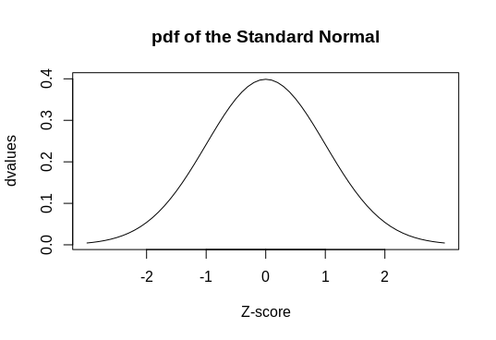
Probability Distributions ...
> plot( # Plot where y = values and x = z_score indexes
dvalues,
xaxt = "n", # Don't label the x-axis
type = "l", # Make it a line plot
main = "pdf of the Standard Normal",
xlab = "Z-score"
)
# These commands label the x-axis
axis(1, at = which(dvalues == dnorm(0)), labels = c(0))
axis(1, at = which(dvalues == dnorm(1)), labels = c(-1, 1))
axis(1, at = which(dvalues == dnorm(2)), labels = c(-2, 2))
<number>

Slide 84
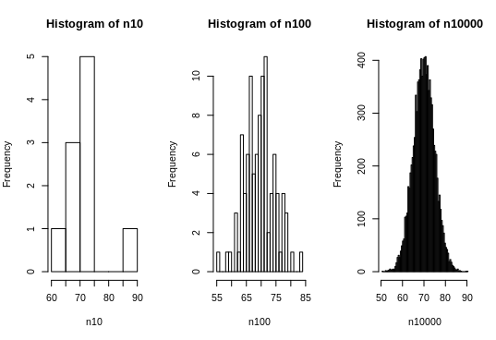
Probability Distributions ...
> pnorm(1.96)
[1] 0.975
> qnorm(0.975)
[1] 1.96
> qnorm(0.975)
> n10 <- rnorm(10, mean = 70, sd = 5)
> n100 <- rnorm(100, mean = 70, sd = 5)
> n10000 <- rnorm(10000, mean = 70, sd = 5)
> par(mfrow = c(1, 3))
# The breaks argument specifies how many bars are in the histogram
> hist(n10, breaks = 5)
> hist(n100, breaks = 20)
> hist(n10000, breaks = 100)
<number>

Slide 85
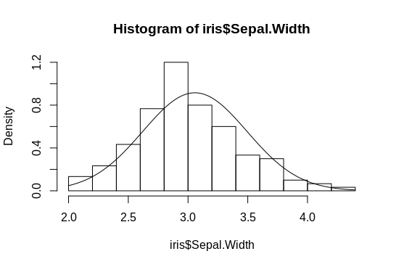
Checking the Normality Assumption
Shapiro-Wilk Test
> shapiro.test(iris$Sepal.Width)
Shapiro-Wilk normality test
data: iris$Sepal.Width
W = 0.98, p-value = 0.1
> hist(iris$Sepal.Width, freq = FALSE)
> curve(
dnorm(x, mean(iris$Sepal.Width), sd(iris$Sepal.Width)),
add = TRUE
)
<number>

Slide 86
Analyzing tabular data
> str(infert)
> help(infert)
> install.packages("dplyr")
> require("dplyr")
> infert.labels <- list("0" = "Control", "1" = "Case")
> infert$status <- dplyr::recode(infert$case, !!!infert.labels)
> infertility.table <- table(
infert$status, (infert$induced + infert$spontaneous)
)
0 1 2 3
Case 7 34 32 10
Control 60 58 42 5
> chisq.test(infertility.table)
Pearson's Chi-squared test
data: infertility.table
X-squared = 27.048, df = 3, p-value = 5.751e-06
<number>

Slide 87
Analyzing tabular data ...
> fit <- glm(
case ~ induced + spontaneous,
family = binomial(link = logit), # logistic regression
data = infert
)
> fit$rsquare <- 1 - (fit$deviance/fit$null.deviance)
> summary(fit)
Coefficients:
Estimate Std. Error z value Pr(>|z|)
(Intercept) -1.7079 0.2677 -6.380 1.78e-10 ***
induced 0.4181 0.2056 2.033 0.042 *
spontaneous 1.1972 0.2116 5.657 1.54e-08 ***
---
Signif. codes: 0 ‘***’ 0.001 ‘**’ 0.01 ‘*’ 0.05 ‘.’ 0.1 ‘ ’ 1
> fit$rsquare
[1] 0.1156308
<number>

Slide 88
Analyzing tabular data ...
We want odds ratios instead of coefficients
> install.packages("questionr")
> require("questionr")
> odds.ratio(fit)
OR 2.5 % 97.5 % p
(Intercept) 0.18125 0.10462 0.2999 1.776e-10 ***
induced 1.51912 1.01599 2.2824 0.04201 *
spontaneous 3.31085 2.21211 5.0865 1.543e-08 ***
---
Signif. codes: 0 ‘***’ 0.001 ‘**’ 0.01 ‘*’ 0.05 ‘.’ 0.1 ‘ ’ 1
<number>

Slide 89
Comparison of Means: t-test
> iris2 <- iris[iris$Species %in% c(
"versicolor", "virginica"
), ]
> iris2 <- iris2 <- subset(
iris, Species == "versicolor" | Species == "virginica"
)
> t.test(Sepal.Width ~ Species, data = iris2)
Welch Two Sample t-test
data: Sepal.Width by Species
t = -3.2058, df = 97.927, p-value = 0.001819
alternative hypothesis: true difference in means is not equal to 0
95 percent confidence interval:
-0.33028364 -0.07771636
sample estimates:
mean in group versicolor mean in group virginica
2.770 2.974
<number>

Slide 90
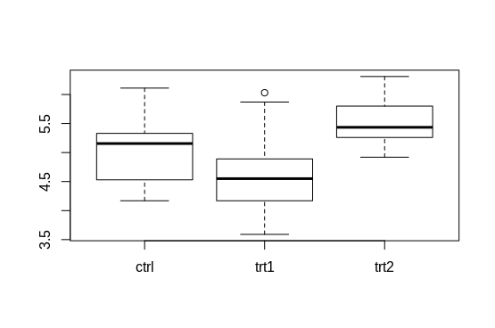
Comparison of Means: ANOVA
> levels(PlantGrowth$group)
[1] "ctrl" "trt1" "trt2"
> boxplot(weight ~ group, data = PlantGrowth)
> anova(aov(weight ~ group, data = PlantGrowth))
Analysis of Variance Table
Response: weight
Df Sum Sq Mean Sq F value Pr(>F)
group 2 3.7663 1.8832 4.8461 0.01591 *
Residuals 27 10.4921 0.3886
---
Signif. codes: 0 ‘***’ 0.001 ‘**’ 0.01 ‘*’ 0.05 ‘.’ 0.1 ‘ ’ 1
> TukeyHSD(aov(weight ~ group, data = PlantGrowth))
$group
diff lwr upr p adj
trt1-ctrl -0.371 -1.0622161 0.3202161 0.3908711
trt2-ctrl 0.494 -0.1972161 1.1852161 0.1979960
trt2-trt1 0.865 0.1737839 1.5562161 0.0120064
<number>

Slide 91
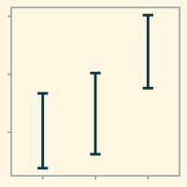
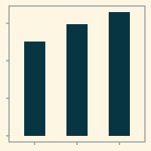
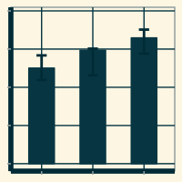
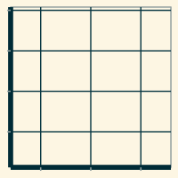
Magical graphics in R
<number>

Slide 92
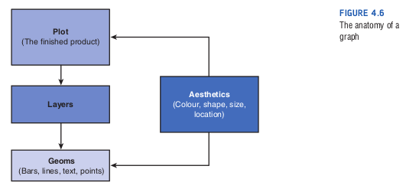
Magical graphics in R
Many people migrate to R only because of its great graphic capabilities.
Field A, Miles J, Field Z. Discovering statistics using R.
Sage publications; 2012.
<number>

Slide 93
R Graphics: geometric options
geom_bar()
creates a layer with bars representing different statistical properties
geom_point()
creates a layer showing the data points
as you would see on a scatter plot.
geom_line()
creates a layer that connects data points with a straight line
geom_smooth()
creates a layer that contains a ‘smoother’
i.e., a line that summarizes the data as a whole rather than connecting individual data points
<number>

Slide 94
R Graphics: geometric options
geom_histogram()
creates a layer with a histogram on it
geom_boxplot()
creates a layer with a box–whisker diagram
geom_text()
creates a layer with text on it
geom_density()
creates a layer with a density plot on it
geom_errorbar()
creates a layer with error bars displayed on it
geom_hline() and geom_vline()
create a layer with a user-defined horizontal or vertical line, respectively
<number>

Slide 95
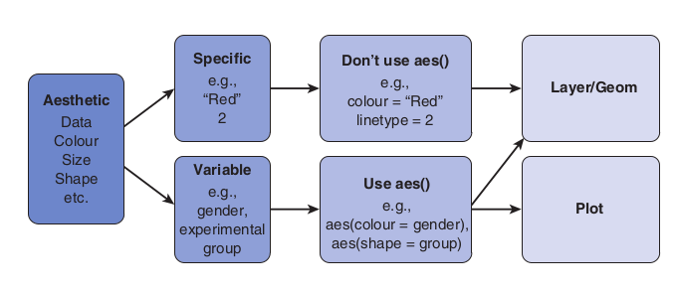
R Graphics: aesthetics
aes()
Field A, Miles J, Field Z. Discovering statistics using R.
Sage publications; 2012.
<number>

Slide 96
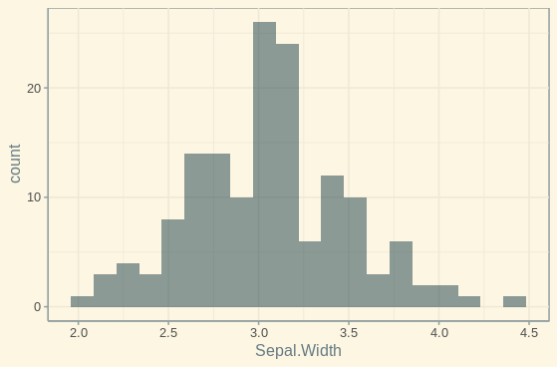
R Graphics: example
ggplot(data = iris, aes(x = Sepal.Width)) +
geom_histogram(
fill = "#002B36",
alpha = 0.45,
position = "identity",
bins = 20
) +
ggthemes::theme_solarized(light = TRUE)
<number>

Slide 97
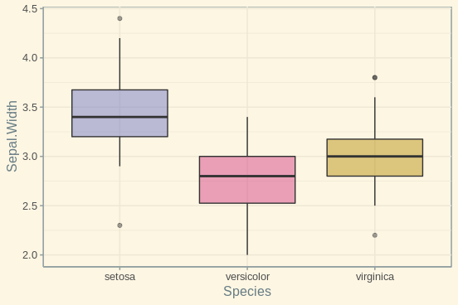
R Graphics: example
ggplot(data = iris, aes(x = Sepal.Width)) +
geom_boxplot(alpha = 0.45) +
ggthemes::theme_solarized(light = TRUE) +
scale_fill_manual(values = c("#6c71c4", "#d33682", "#b58900")) +
guides(fill = FALSE)
<number>

Slide 98
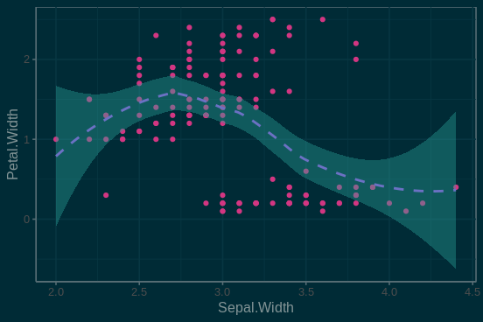
R Graphics: example
ggplot(data = iris, aes(x = Sepal.Width, y = Petal.Width)) +
geom_point(color = "#d33682") +
ggthemes::theme_solarized(light = TRUE) +
geom_smooth(
method = "loess",
linetype = "dashed",
color = "#6c71c4",
fill = "#2aa198"
) +
guides(fill = TRUE)
<number>

Slide 99
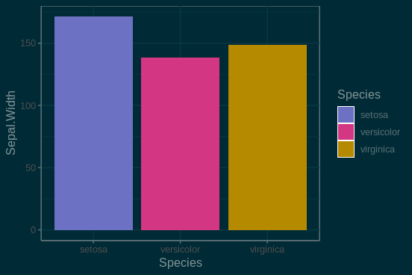
R Graphics: example
ggplot(
data = iris, aes(x = Species, y = Sepal.Width, fill = Species)
) +
geom_bar(stat = "identity") +
ggthemes::theme_solarized(light = FALSE) +
scale_fill_manual(values = c("#6c71c4", "#d33682", "#b58900"))
<number>

Slide 100
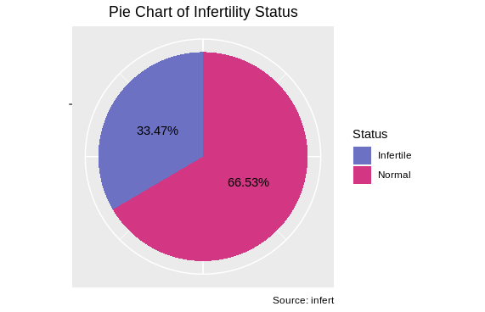
R Graphics: exercise
<number>

Slide 101
References
1. Wickham H. Advanced r. Chapman and Hall/CRC; 2014.
2. Keramat Nouri, Introductory R. Workshop Slides. 2018.
3. Field A, Miles J, Field Z. Discovering statistics using R. Sage publications; 2012.
<number>

